Slide 1


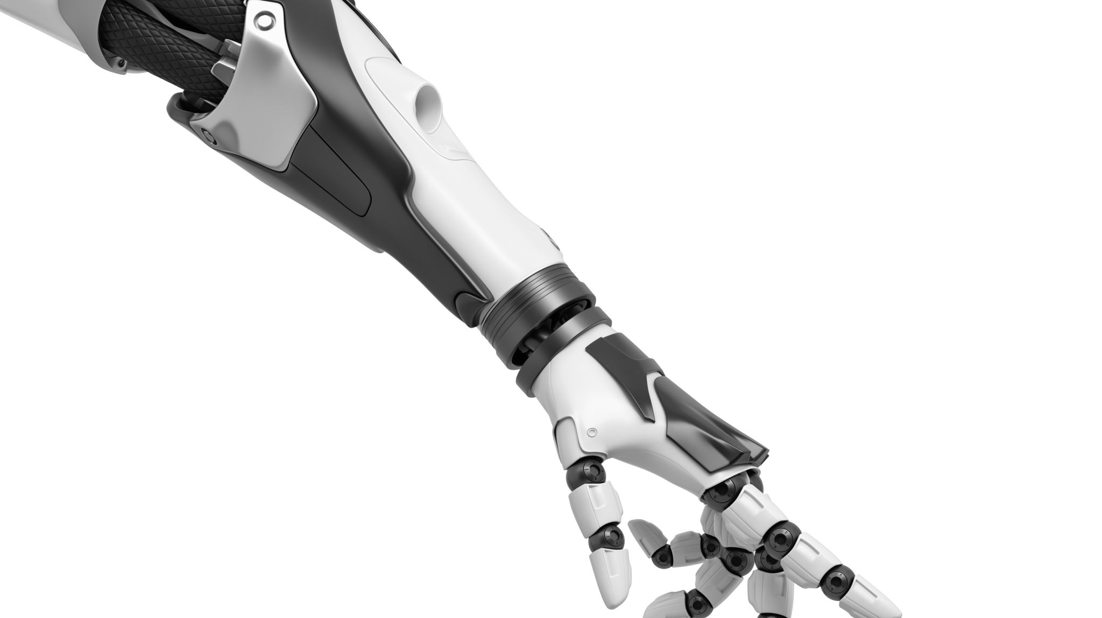
FEEDBACK CONTROL OF A ROBOTIC ARM
ROBOTICS PROJECT

Slide 2
SUMMARY
I - Problematic
II – Previous work on the arm
III – Problems encountered
IV – Our work and solutions
V - Results

Slide 3
I - PROBLEMATIC
How to stabilise the robotic arm, driven by two propellers both at the respective ends of the arm, to a baseline angle ?
Is it possible to link the movement of the arm to the one of a joystick ?
Is it possible to create a simulation of the arm on Qt ?

Slide 4
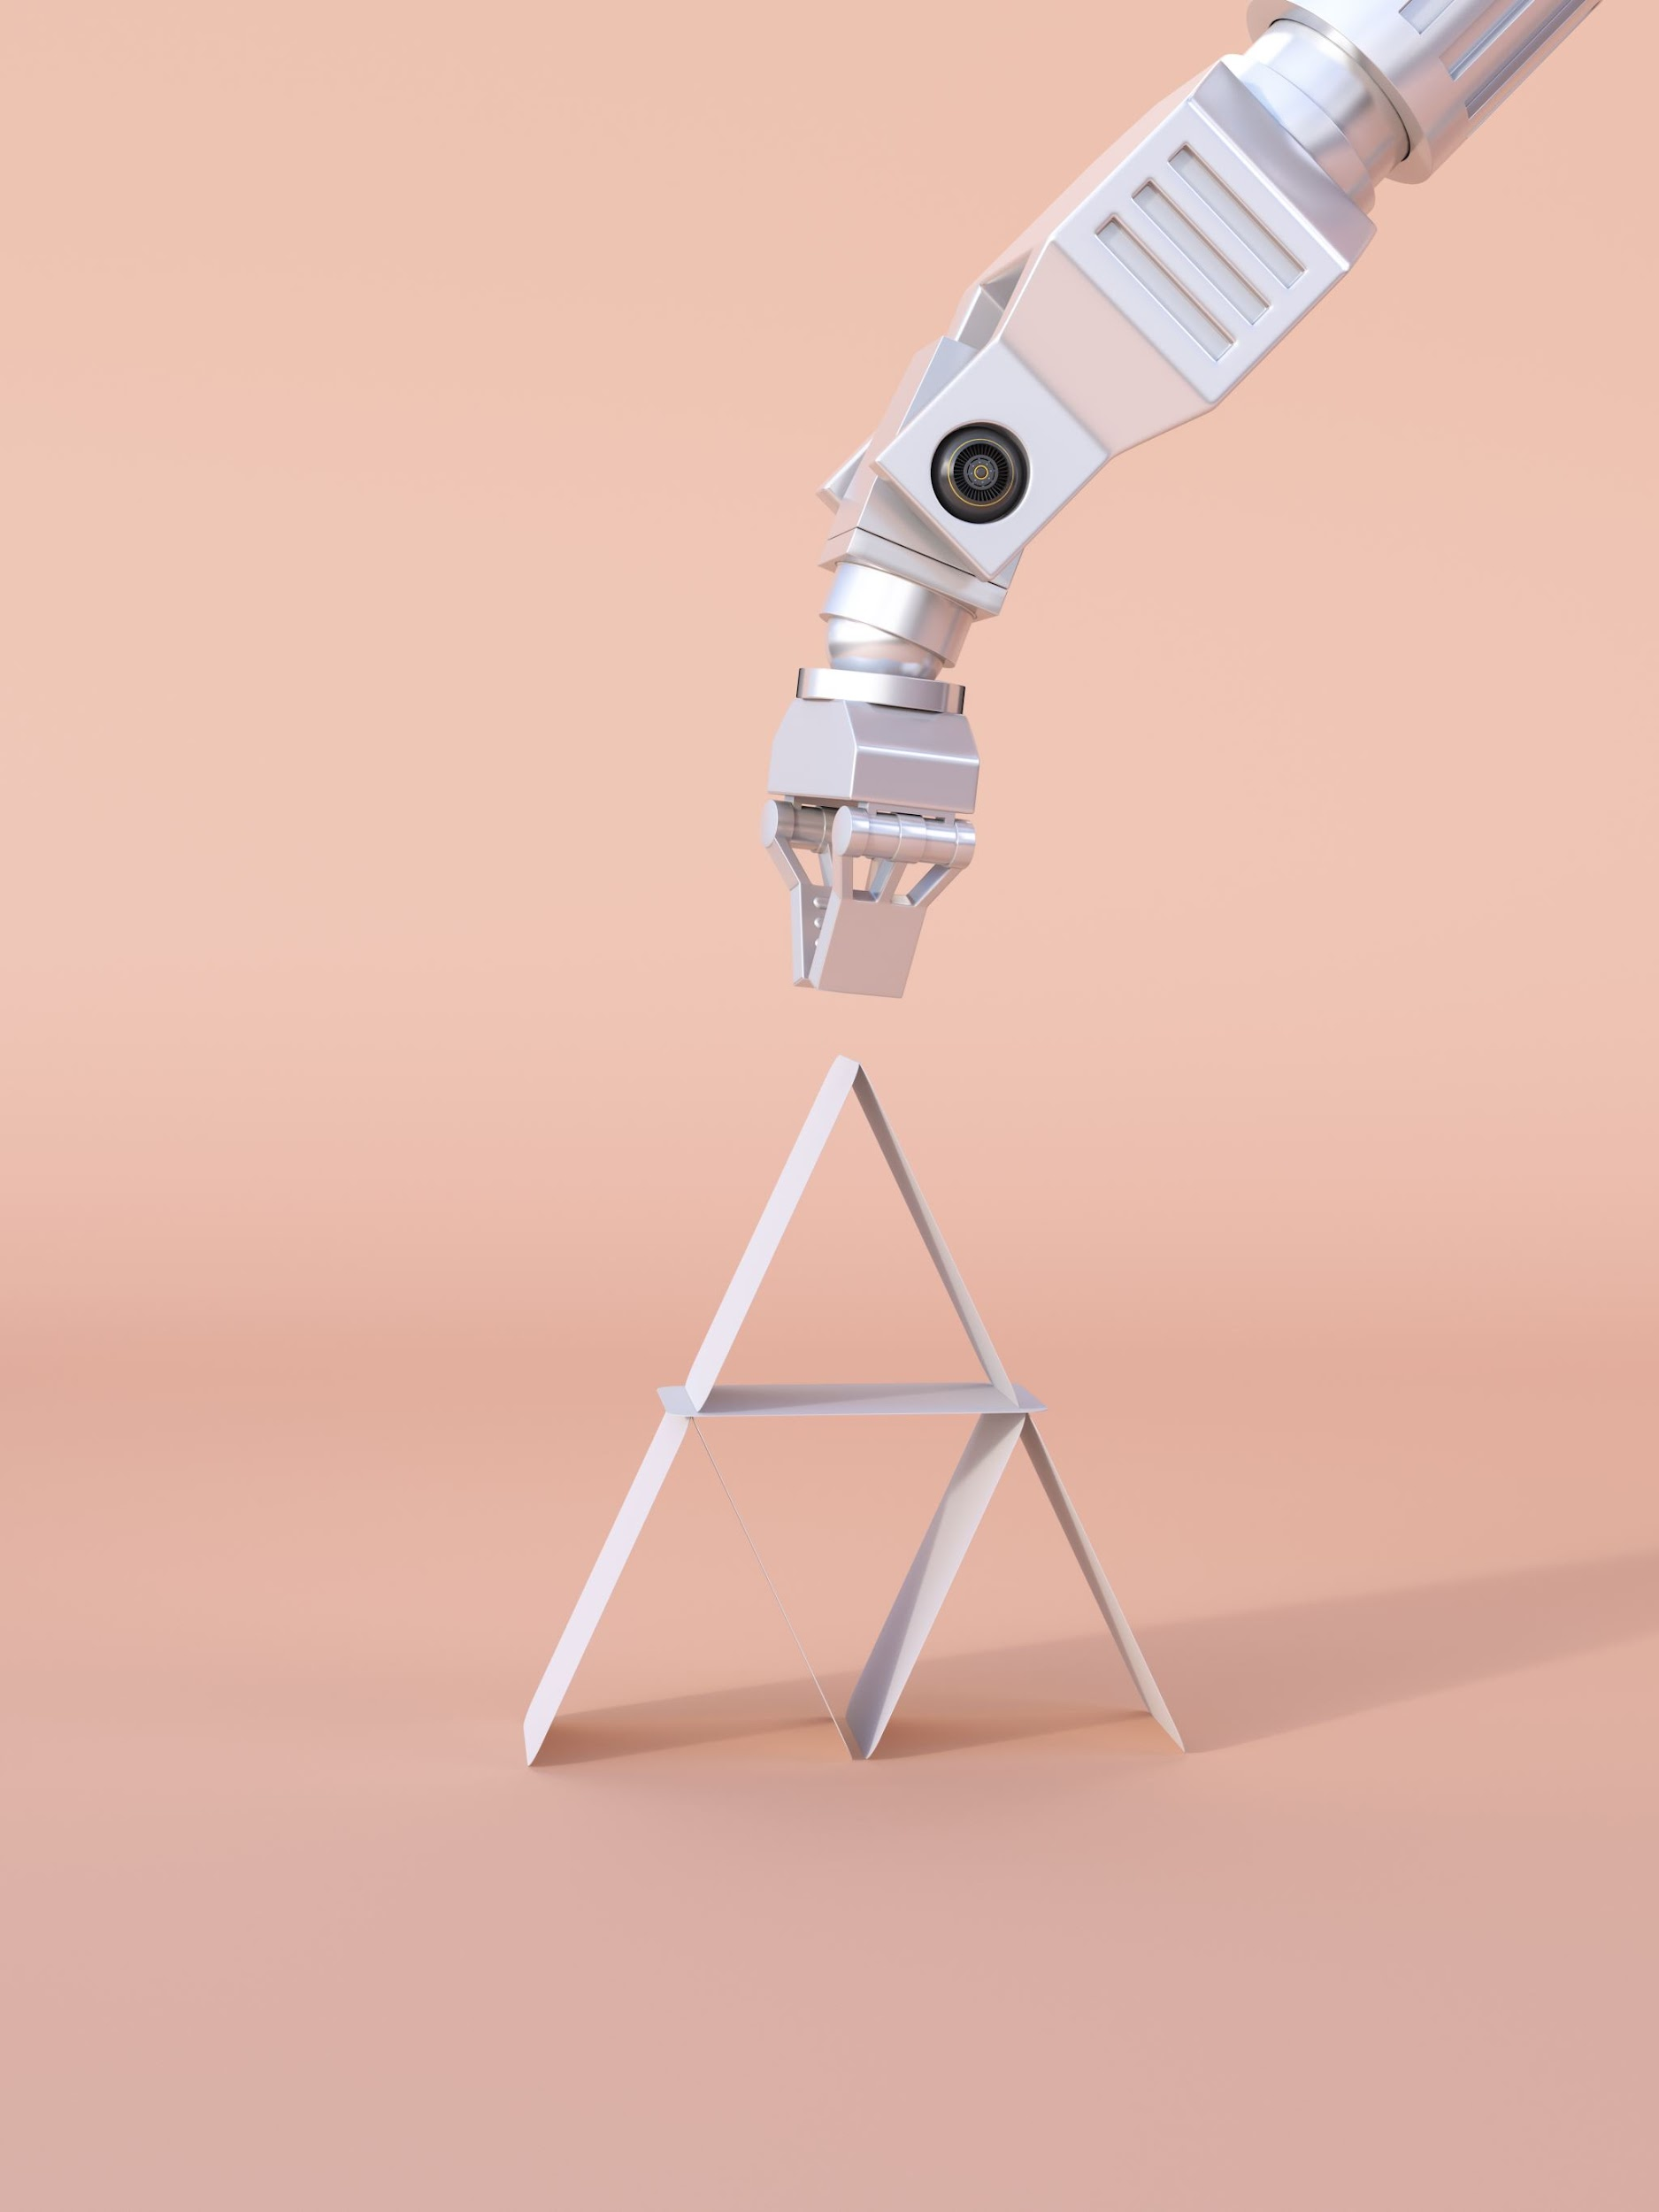
EQUIPMENT USED
Robotic arm with two propellers at each end of the arm, powered by Dualsky XM2830CA-14
EMAX ESC-30A ESCs
STM32F411 card
Converter 3.3V to 5V
10V Power Supply
Welding tool

Slide 5
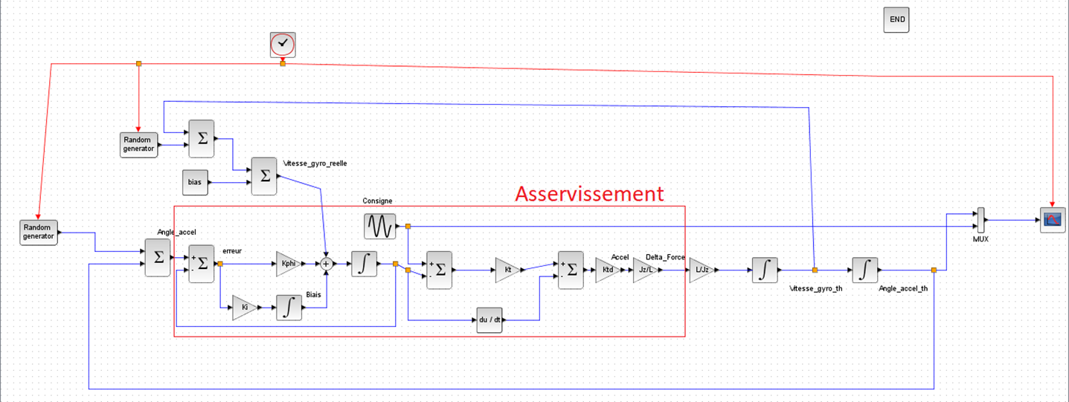
II – PREVIOUS WORK ON THE ARM
Theoretical feedback control of the arm

Slide 6

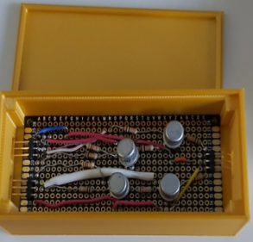
Problem : The arm was not behaving as expected !
Coding of the feedback control
Voltage Converter

Slide 7
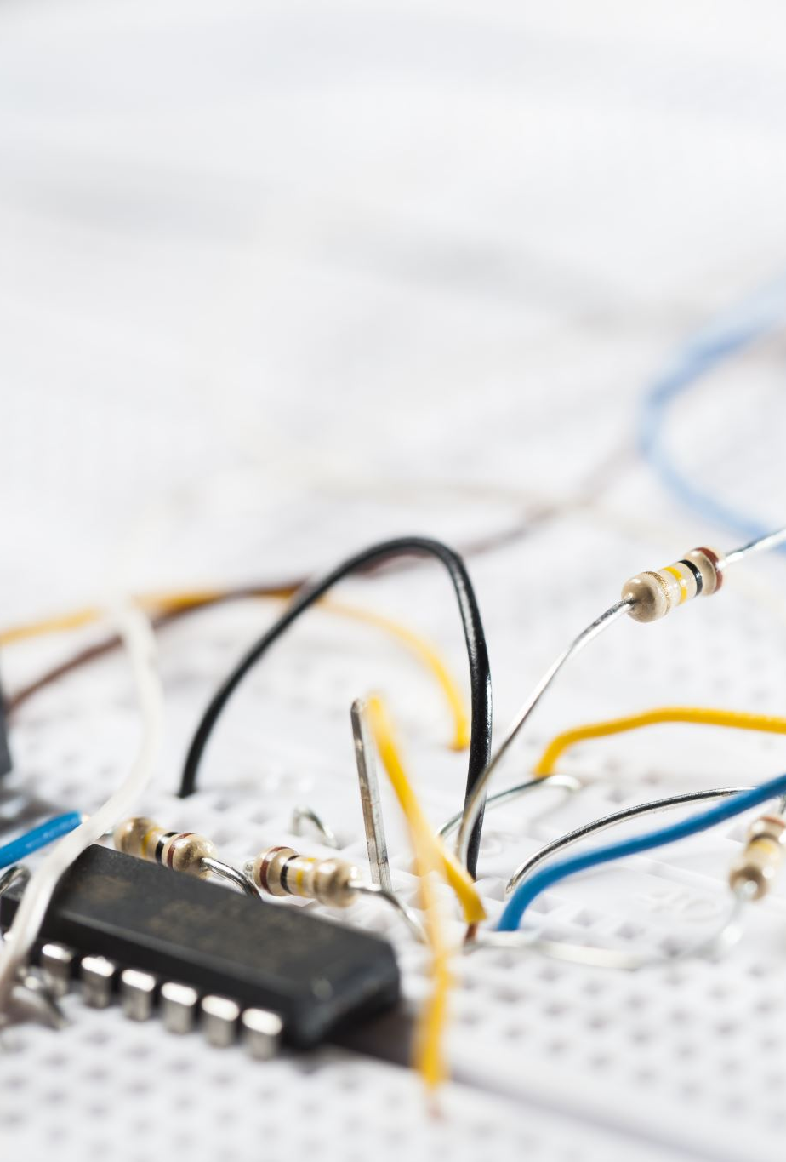
III – PROBLEMS ENCOUNTERED
Flaws in the feedback control
Solution for the voltage conversion take too much space
ESCs were broken
ESC cables were welded to the motor cables

Slide 8
IV – OUR WORK AND SOLUTIONS
Modelisation of the whole system:
the physical system
filtering
feedback control
adaptation of the command

Slide 9
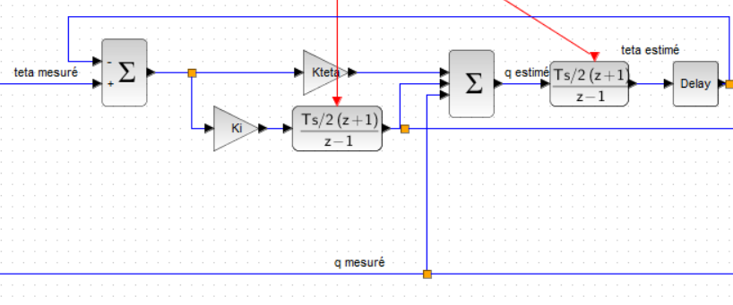
Complementary filter

Slide 10
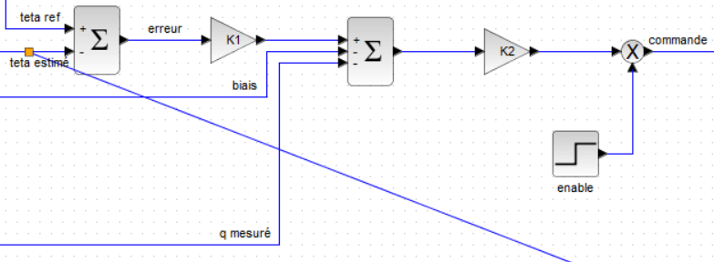
Cascading control

Slide 11
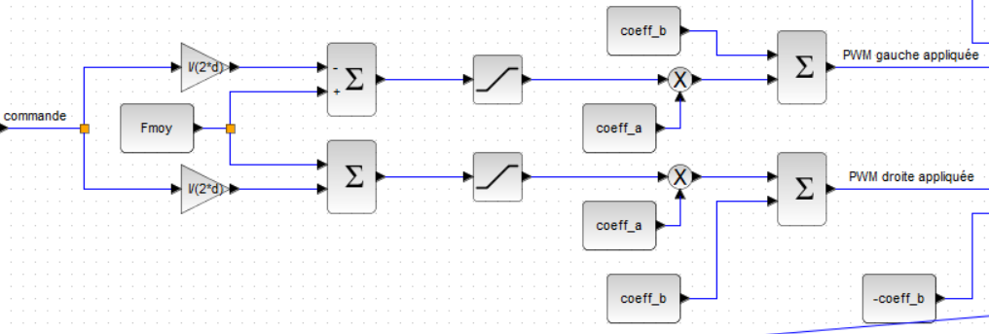
Adaptations of the commands

Slide 12
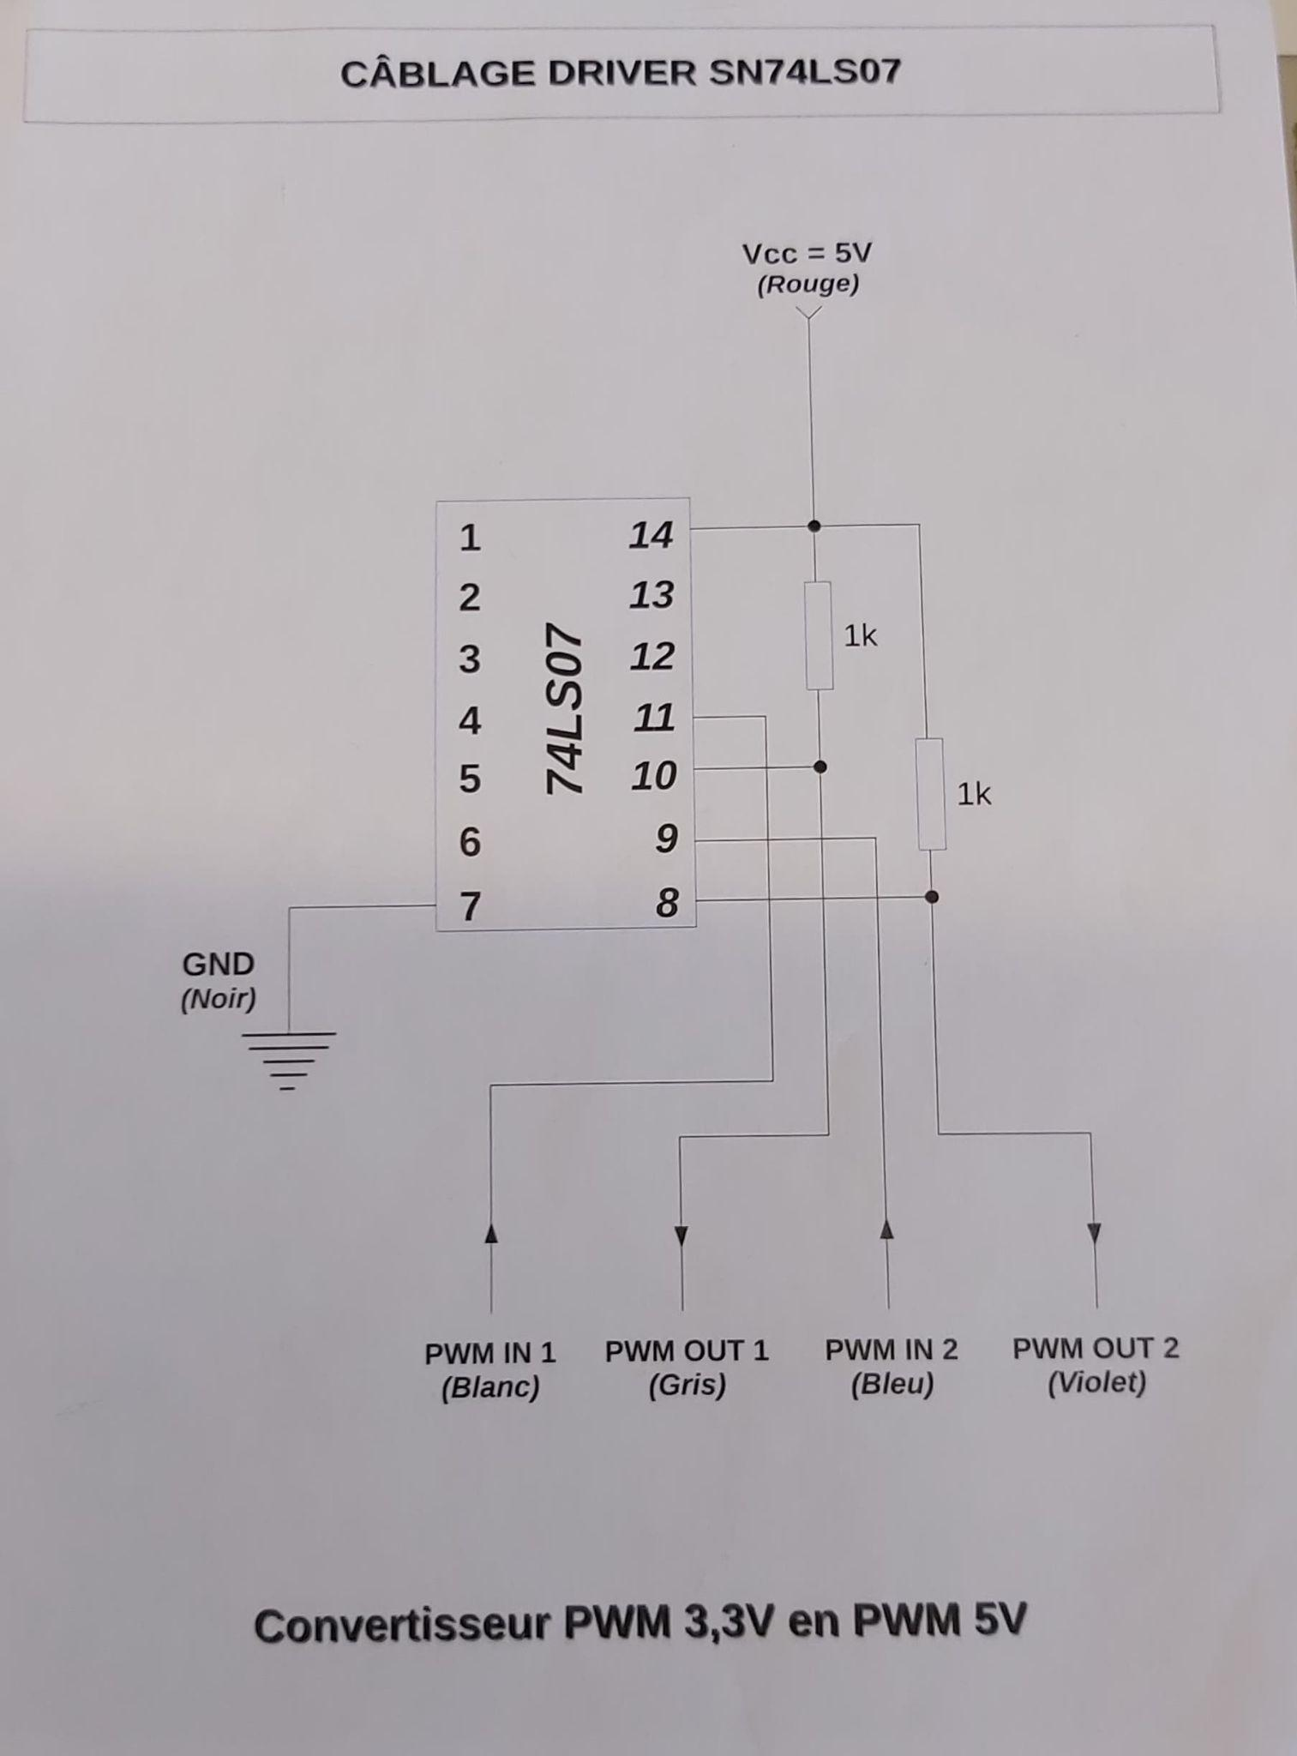
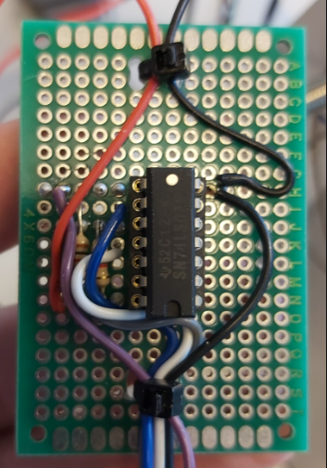
Change of the voltage converter box into a smaller solution

Slide 13
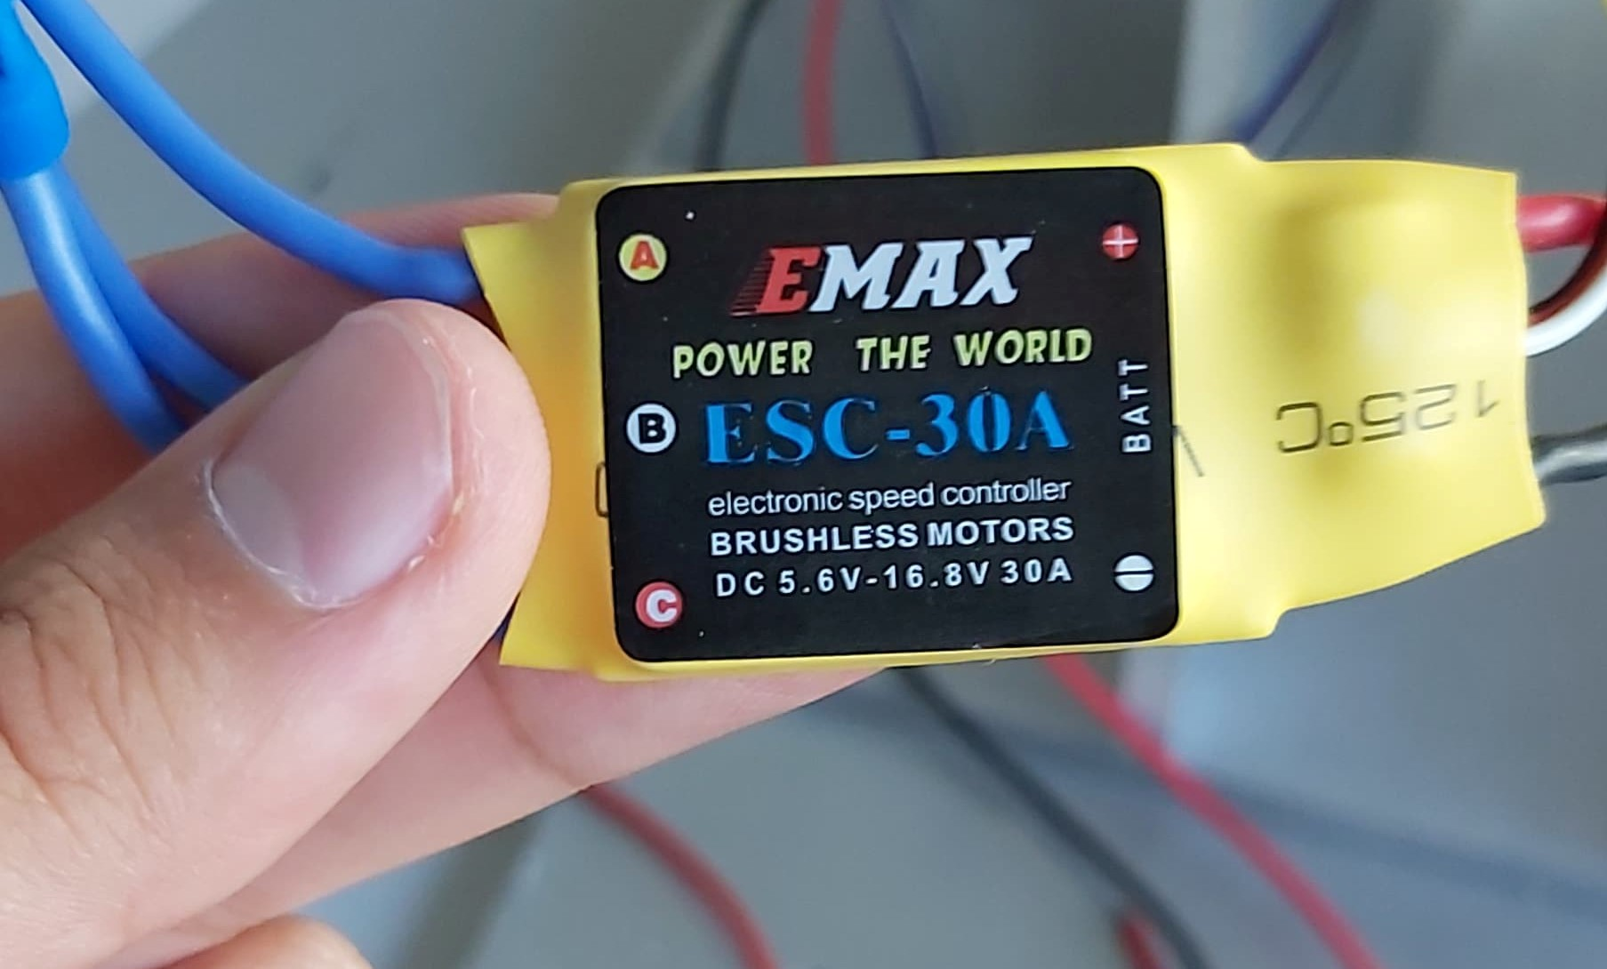
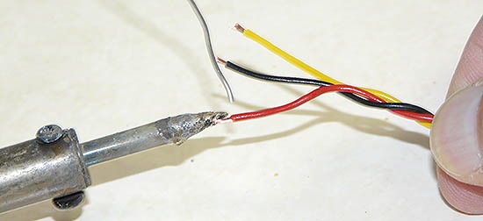
Replacing the broken ESCs by new ones
Welding of the new cables of the ESCs

Slide 14
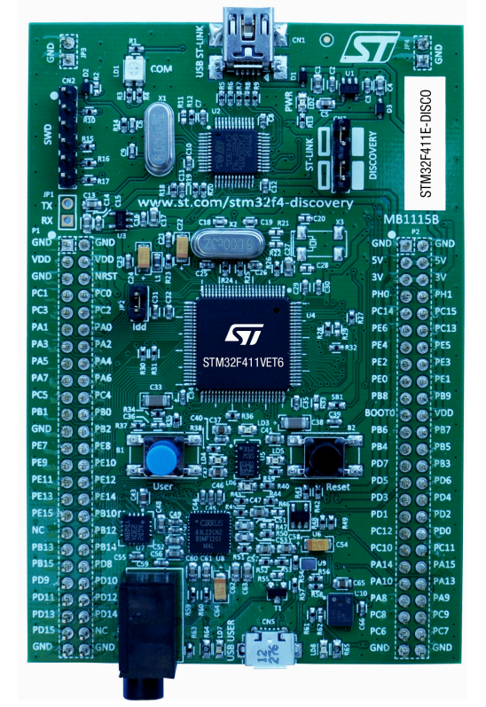
How to connect the STM32 card :
Motor control :
PD12 → Left PWM (black)
PD13 → Right PWM (yellow)
GND
Serial Communication :
PA2 → RX (blue)
PA3 → TX (orange)

Slide 15
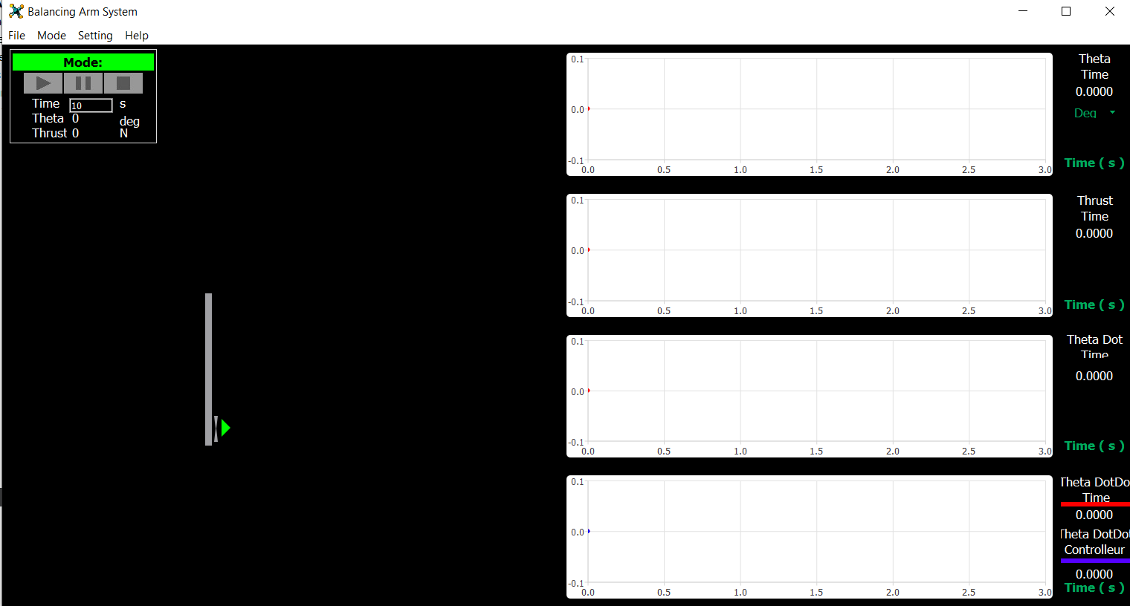
Qt modelisation

Slide 16
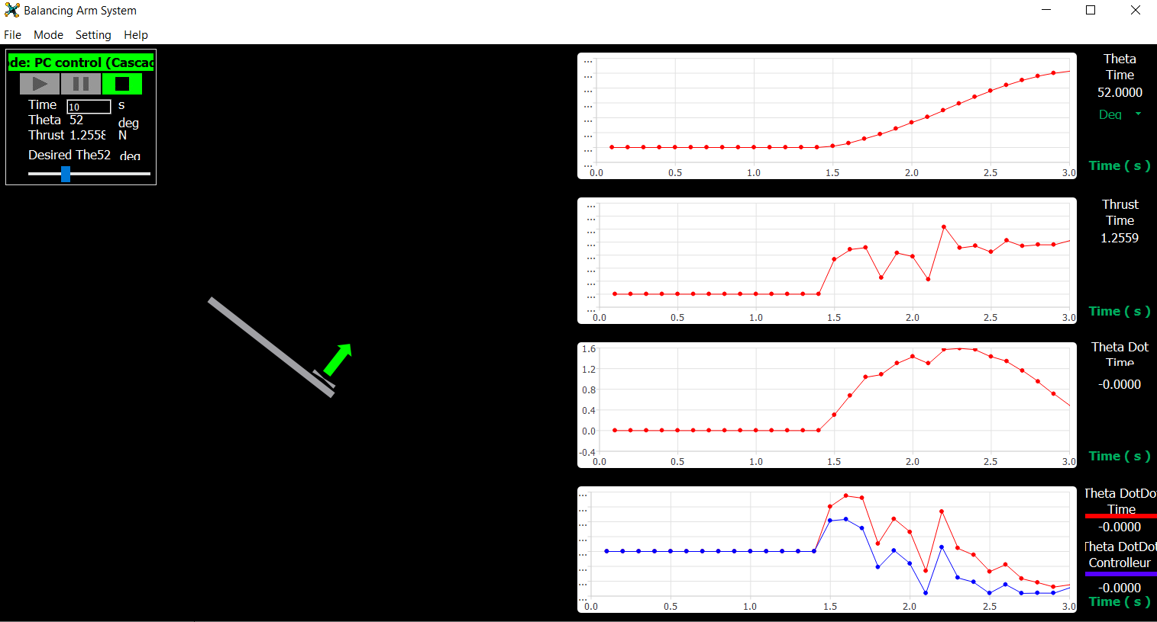
Qt modelisation
Example for Theta= 52 degree

Slide 17
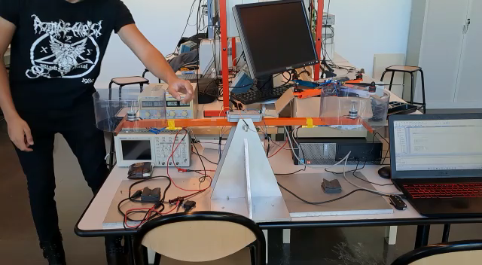
V - RESULTS
Show the video of working arm

